Slide 1


Slide 2
EasySave by prosoft
Notes:
Presentation of the présenters
Why we are here

Slide 3





EasySave by prosoft
Introduction
Product specifications
Hands on
Technical specifications
Possible evolutions
Pricing policy
Notes:
0’ – 2’
Reminder of the subject
Summary presentation

Slide 4






EasySave by prosoft
Product specifications
Notes:
2’ – 5’
Stack : Multiple simultaneous tasks
Graph : Ressources handling with file size or priority files
People : Multiple users
Wifi : remote connection
Shield : Security file encryption

Slide 5
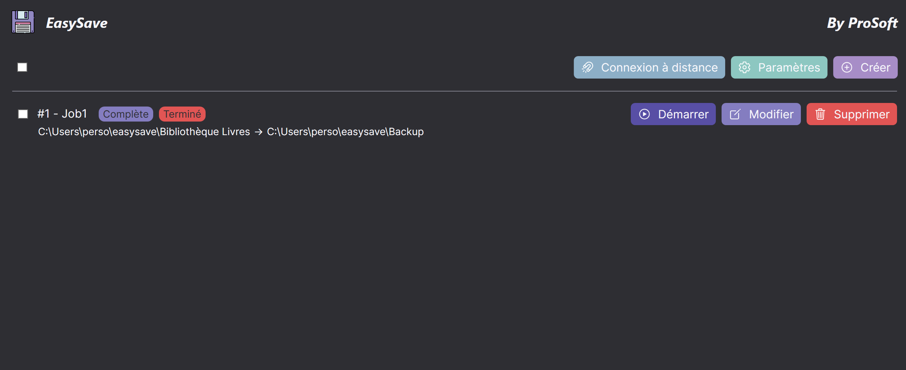
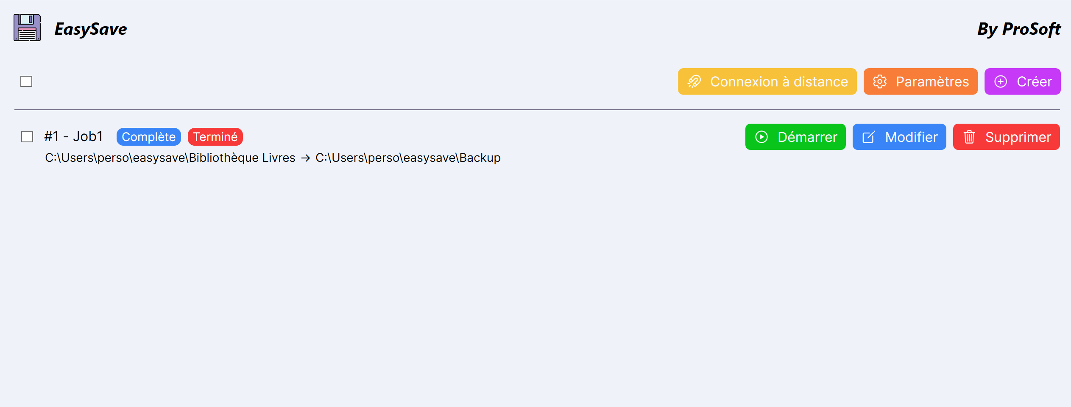
EasySave by prosoft
Hands on
Notes:
5’ – 10‘
Download of the exe from git hub
Job creation
Job exécution with priority and large file transfer
Remote connexion

Slide 6
EasySave by prosoft
Technical specifications
Design patterns
Inter-instance communication
Security
Continuous integration
Notes:
10’ – 14‘
Design patterns :
Composite [File Tree],
Factory []
Sigleton [logs],
Inter instance comm -> Sockets
Security -> xor encryption
Continuous integration -> code coverage, SonarQube

Slide 7
EasySave by prosoft
Possible evolutions
Remote job creation
Remaining time
Information about cpu and disk usage
Better encryption
Notes:
14’ – 18‘

Slide 8

EasySave by prosoft
Pricing policy
Starting at
200 € Hc

Slide 9
EasySave by prosoft
Pricing policy
For companies
service contract 5/7 8am-5pm
12% price with SYNTEC index reconduction

Slide 10
EasySave by prosoft
Pricing policy
Estimated ROI
3 months
Notes:
Depending on the time the product is send to the market,
With our remuniration + after sale service will be called during the time users acquire the skills

Slide 11
EasySave by prosoft

Slide 13











EasySave by prosoft
Assets

